Slide 1
CWA Advanced Class Notes
Joe Attili – AA2IL
September-October, 2022

Slide 2
Session 0
Meet and Greet
Introduce ourselves
Test Zoom and Sidetone audio
Do first three h/w assignments before 1st class

Slide 3
Overview
8-weeks (M & Th 7-8PM on West Coast)
  Please use headphones!!!
Daily Practice
  Two 15-minute sessions per day is much more effective than one 4-hour block once per week
  Homework: Short stories, QSOs and CWT exchanges
  RufzXP and MorseRunner
  GET ON THE AIR!!!
In-class exercises will reinforce skills but are no substitute for practice and OTA time
I will supplement each class with related topics to help improve your operating skills and overall enjoyment of our great hobby

Slide 4
Philosophy
Its a hobby, not a competition!
  Keep it fun!!!
Just like OTA, there are different skill levels coming into this class
  Compare yourself to yourself, not your classmates
  Don’t get frustrated or worry about slowing others down
  More skilled ops, PSE QRS! GET THE MESSAGE THROUGH!!!
Challenge yourself
  Listen to homework a little faster than you are comfortable with
  Strive to make a few more QSOs in the CWT
  Practice sending a little faster …
Practice, get OTA and HAVE FUN!!!

Slide 5
About AA2IL
Grew up in Upstate New York, moved to San Diego in 1993 (job transfer)
First licensed in the late 1970s as a teenager
  Went silent for over 20-years
Retired last year after 35-years as an Electrical Engineer (signal processing)
Radio activities include
  Chasing DX and contesting
  VHF/UHF contesting and satellites
  Antennas, Linux software development and micro-controllers
Modest station
  100W and wire antennas
Took this class last spring because couldn’t seem to get my “fist” back and wanted to see how it all worked
  Surprised at how crucial daily practice was to improving speed

Slide 6
Week 1 - Session 1
Go over h/w
Get on the air!
Word game
  Animals
  Colors

Slide 7
GitHub Repository
I have set up a repository on GitHub for items related to CW and this class:
  https://github.com/aa2il/CWA
There have been complaints about the “new” CWA practice files. I have uploaded the “old” versions of these files there. Use these instead if you prefer.
Poke around and feel free to suggest other material to include there

Slide 8
Session 2
Go over h/w & on the air activities
Go over settings for MorseRunner and RufzXP
Round Robin Short sentances
  Something you might say in a QSO

Slide 9
Week 2 - Session 3
Questions on h/w & on the air activities?
Contesting Intro
Simulated SST
  Each student gets to run and others call

Slide 10
Why Radio Sport?
Major activity in our hobby
Fun Competition
  Some say its the most fun you can have with your clothes on
Become a better operator
  Difficult conditions
  Emergency Comms
Quickly rack up entities for “paper chasing”
Dormant bands suddenly light up
Test effectiveness of your station
…

Slide 11
Some Terminology
Runner
  Station Calling CQ (soliciting contacts)
  Usually achieve a higher QSO rate, especially if you are a “big gun”
  Need to be able to recognize calls and exchanges without too many repeats
Search and Pounce (S&P)
  Tune across band answering runners
  Often lower rate because you are competing with other S&Pers
  Much easier – can listen to runner until you get call and info
    Be careful with serial numbers, not always consecutive
  Often a better strategy for “little pistols” in larger contests
Some mix of these is needed to work everybody

Slide 12
Some More Terminology
SO1R/SO1V – Single Operator, One Radio/One VFO
  Most of us mere mortals
SO2R – Single Operator, Two (or more) Radios
  Generally running on one radio and searching for multipliers on the other
2BSIQ – Two-band Simultaneous Interleaved QSOs
  Running on two bands, alternating CQ calls
SO2V – Single Operator, Two VFO’s
  One transmitter and two receivers (one in each ear)
Multi-Operator
  Larger contest stations with two or more ops

Slide 13
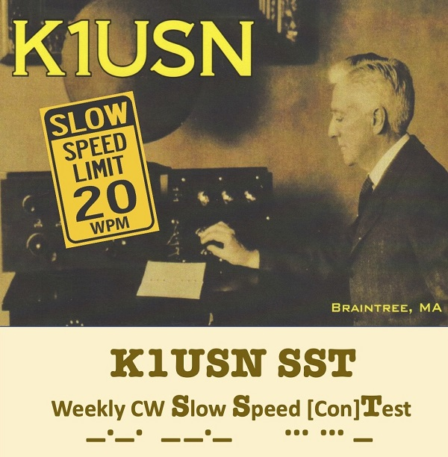
SST Weekly Practice Contest
“Slow” Speed Test
Friday 2000z and Monday 0000z
Very Relaxed Pace - Speed limit is 20 wpm
Exchange: NAME and STATE
    CQ SST N7KOM
                KM6GOX
    KM6GOX TU TIM OR
                GE TIM DEREK CA
    GE DEREK 73 N7KOM
Great place to get used to contesting and to try running

Slide 14
Session 4
Go over h/w and on air activities
Loose ends
  WebSDR.org
  EU Contests: MWC, NTC (Dutch) QSO Parties
    https://memorial-ok1wc.cz
    https://pi4ntc.nl/ntcqp
Upcoming contests
Round-robin word game
  Words related to a car
  Words related to a hardware store

Slide 15
UPCOMING CONTESTS
CQ WW RTTY
  Very popular and good way to get ready for CQ WW CW in November
  This coming weekend starting at 0000z Saturday for 48-hours
  Everybody works everybody
  Condx have been good this week
California QSO Party
  More competitive than most state QPs
  Oct 1 1600z through Oct 2 2200z
  Exchange:
    CA stations send SERIAL No. and COUNTY
    Non-CA send SERIAL No. and STATE
  CW QSOs count 1.5x Phone QSOs (no digi contacts)

Slide 16
Week 3 - Session 5
Go over h/w and on air activities
Upcoming contests
  CQP this coming weekend
Practice Contests
  MST and CWT

Slide 17

MST Weekly Practice Contest
Medium Speed Test
Monday 1300z and 1900z, Tuesday 0300z
Relaxed Pace - Speed limit is 25 wpm
Exchange: NAME and SERIAL No.
    CQ MST NJ7V
                SV2HUD
    SV2HUD TU RED 28
                TU VAS 37
    TU VAS 73 NJ7V
Great place to build up confidence and skill

Slide 18
CWT Weekly Practice Contest
Wednesday 1300z and 1900z, Thursday 0300z and 0700z
Very popular and very fast – average speed ~39 wpm
Exchange: NAME and MEMBER No. or STATE or “CWA”
    CQ CWT AA2IL
                N7AUE
    N7AUE TU JOE 3177
                TU JIM NV or JIM CWA or JIM 3237
    73 AA2IL or R or EE or GL JIM 73 EE
If you are aspiring to become a member of CWops, this is the easiest place to get your call recognized and build up sponsorship

Slide 19
Session 6
Go over h/w and on air activities
Loose Ends:
  CQP is this weekend – practice session at 4:30-5:00 PM tomorrow
  AZ and NV QPs are next weekend
  We will be discussing logging on Monday
    Current thread on CWops email reflector regarding logging
    Recent thread on CWT Strategy
Anatomy of a QSO
  Hit and Run
  Rag Chew
Round-robin Sentences
  Next week, we’ll try full QSOs

Slide 20
“Hit and Run” QSOs
By convention, a valid QSO must exchange some type of information in addition to call signs
However meaningless, the minimal amount of “information” is a signal report
Example – A “rare” DX station running a pile-up
  His goal is to work as many stations as possible
  CQ 3YOJ UP
                NJ7V
    NJ7T 5NN
                TU 5NN
    R 3YOJ UP

Slide 21
“Hit and Run” QSOs (cont.)
The goal of (most) contesters is also to work as many stations as possible but there is a prescribed exchange
Example – California QSO Party
CQ CQP AA2IL/6
                N7AUE
    N7AUE TU 123 SDIE
                TU 456 NV
    73 AA2IL/6

Slide 22
Short QSOs
Special Event, POTA, SOTA, etc. ops also are generally trying to work as many stations as possible so they might only send a 5NN signal report
Some ops will exchange more meaningful information quickly
Example – A not-so-rare DX station who’s not in a hurry
  CQ CQ CQ SV2HUD SV2HUD
                KM6GOX KM6GOX
  KM6GOX GM 559 559 OP VAS BK
                GM VAS UR 569 IN CA CA OP DEREK BK
  QSL DEREK TNX ES 73
                TU VAS 73

Slide 23
Rag Chew QSOs
There’s no precise definition for a “rag chew” QSO but they generally begin with “the big three”
  Signal Report (RST)
  Location (QTH)
  Name (OP)
  CQ CQ CQ AA2IL AA2IL AA2IL K
  AA2IL DE KB1FGC KB1FGC KN
    KB1FGC DE AA2IL = GE OM ES TNX FER CALL = UR 57N 57N IN RAMONA, CA RAMONA, CA, ABT 30 MILES NE OF SAN DIEGO = NAME HR IS JOE JOE = HOW CPY? <AR> KB1FGC DE AA2IL <KN>
  AA2IL DE KB1FGC RR FB JOE TNX FER RPRT, SOLID COPY = UR RST 55N
  55N = OP IS RICH RICH ES QTH IS PROSPECT, CT PROSPECT, CT = HW? BK

Slide 24
Rag Chew QSOs (cont.)
At this, I can continue the QSO or politely end it
  KB1FGC DE AA2IL = RR SOLID CPY RICH ES GUD TO MEET U = XYL IS RINGING DINNER BELL SO MUST SAY 73 FOR NW = HPE CU AGN SN = 73 <SK> KB1FGC DE AA2IL <KN>
  AA2IL DE KB1FGC = FB JOE TNX FER QUICK CHAT ES WILL LOOK FER U AGN 73 73 <SK> AA2IL DE KB1FGC K EE
  EE
There is a lot more detail than in a “Hit an Run” QSO
A lot of jargon and abbreviations are used to shorten the messages
I like to use the “break” or “double dash” to separate various thoughts and also to bide a little time while I’m thinking of the next thing to say
I also like to use accepted pro-signs to help with flow of transmissions

Slide 25
Rag Chew QSOs (cont.)
If we both choose to continue the conversation, there are a lot of things to talk about:
  KB1FGC DE AA2IL = RR SOLID AGN = RIG HR IS A YAESU FTDX300 ABT 100W TO A MOXON BEAM UP 30 FT = WX HR TODAY SUNNY AND HOT, TEMP NR 100 DEG F = SO BTU RICH <KN>
  R FB JOE DIDNT MISS A DIT = UR RIG AND ANT DOING NICE JOB HR IN CT = RIG HR IS KNWD TS2000 WID AMP RUNNING 500W TO A DIPOLE UP 45 FT = WX HR IS COOL AND RAIN, TEMP IN LOW 50S = FALL IS HR IN THE GREAT NE = BTU JOE KN
  VY GUD RICH = I GREW UP IN UPSTATE NY AND MISS THIS TIME OF YR = WENT TO THE BEACH WID MY XYL YESTERDAY TO REMIND US WHY WE LIVE HR HI HI = I RETIRED LAST YR AFTER 35 YRS AS AN ELEC ENGR = NW I HV LOTS OF TIME TO PLAY RADIO = WHAT DO YOU DO FOR WRK RICH? <KN>
  AA2IL DE KB1FGC R SOLID AGN JOE = MY FAMILY RUNS AN ANTIQUE TRUCK MUSEUM AND I USED TO DRIVE BIG RIGS = BEEN A HAM FER 25 YRS, I ENJOY CW RAG CHEWING AND CHASING DX. I ALSO LIKE TO REPAIR VINTAGE RIGS AND IM WORKING ON A SATELLITE SETUP
  ...
… and so on and so on
Be sure to identify every 10-minutes
Keep subject matter friendly and upbeat and non-controversial

Slide 26
Week 4 - Session 7
Go over h/w and on air activities
Upcoming contests
  AZ and NV State QPs this coming weekend
Logging
Short QSO Drill
  Not so rare DX
  Slow day as SES/SOTA/POTA

Slide 27
Computers and Logging
Computers are a fixture in most ham stations now and are invaluable for contesting
  Logging & Scoring
  Keeping track of duplicates
  Sending
N1MM logger is the most popular logging program used for contesting
  Many useful features
  Windoz Only
  No comparable option for Linux
At this point, you should be using a contest logger
  Its a good idea to let the computer do sending for you (other ops will appreciate machine code)
  Also, use the “band map” to help with S&P (verify call sign!)
Do not use the “call history files” and “auto-fill” until you can consistently copy exchanges
  When you begin to use these features, you still need to verify that the information is correct

Slide 28
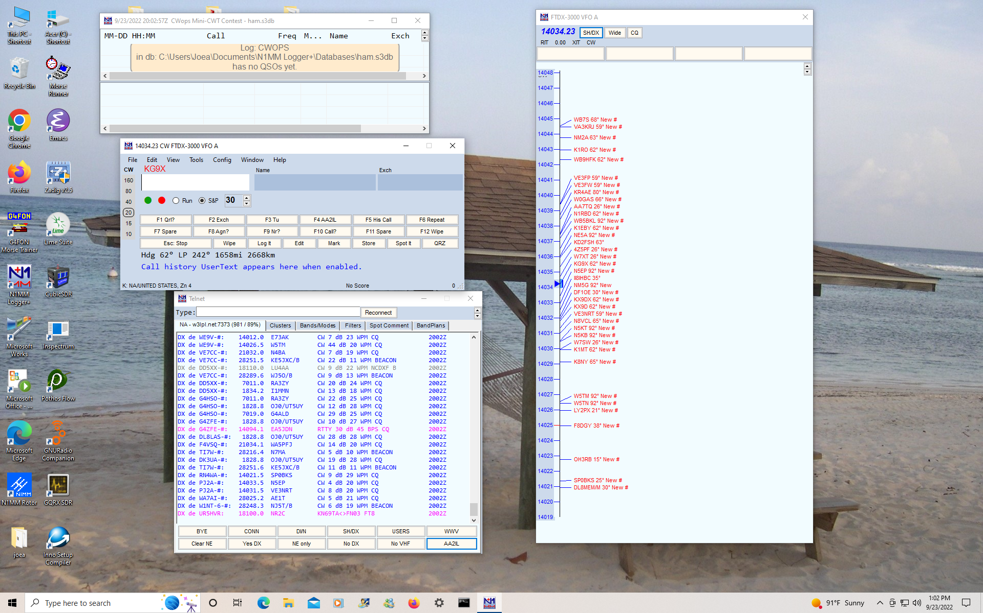
N1MM Logger

Slide 29
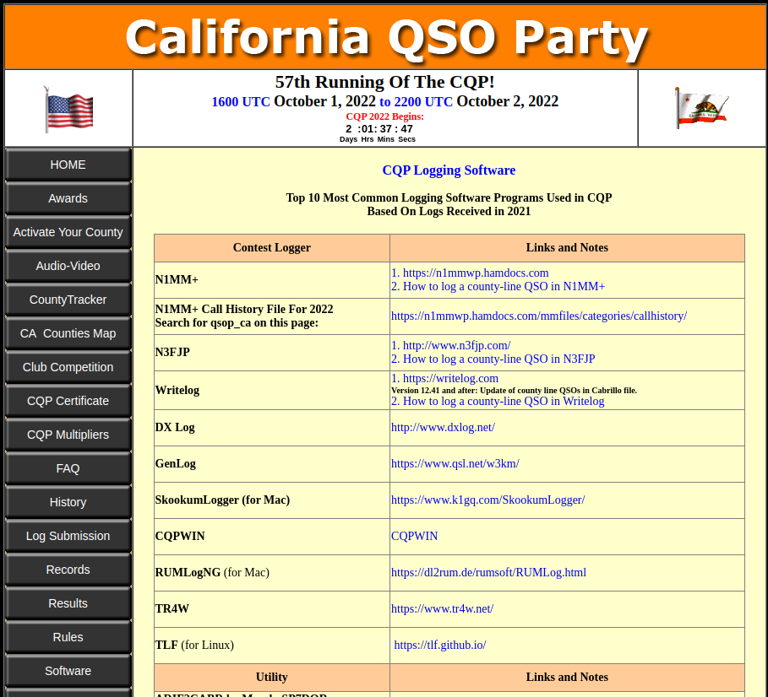
Other Loggers

Slide 30
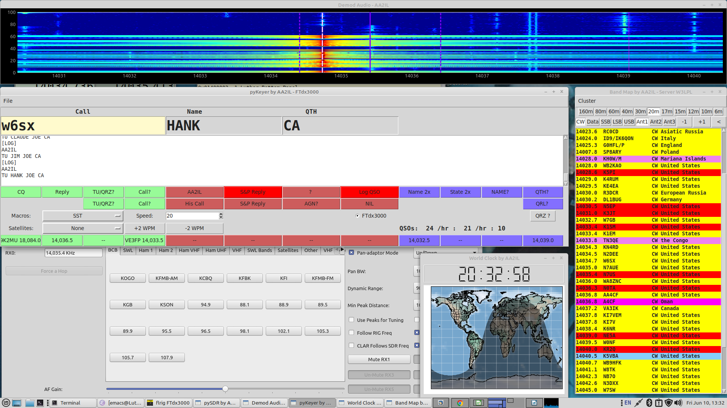
My Screen During a Contest

Slide 31
Short QSOs
Special Event, POTA, SOTA, etc. ops also are generally trying to work as many stations as possible so they might only send a 5NN signal report
Some ops will exchange more meaningful information quickly
Example – A not-so-rare DX station who’s not in a hurry
  CQ CQ CQ SV2HUD SV2HUD
                KM6GOX KM6GOX
  KM6GOX GM 559 559 OP VAS BK
                GM VAS UR 569 IN CA CA OP DEREK BK
  QSL DEREK TNX ES 73
                TU VAS 73

Slide 32
Week 4 - Session 8
Go over h/w and on air activities
I may need some help with class next Thursday
Upcoming contests
  AZ and NV State QSO Parties are this coming weekend
Rag Chew QSOs
  CQ/Greeting
  “Big Three:” RST, Name, QTH
  Wrap-up

Slide 33
Rag Chew QSOs
There’s no precise definition for a “rag chew” QSO but they generally begin with “the big three”
  Signal Report (RST)
  Location (QTH)
  Name (OP)
  CQ CQ CQ AA2IL AA2IL AA2IL K
  AA2IL DE KB1FGC KB1FGC KN
    KB1FGC DE AA2IL = GE OM ES TNX FER CALL = UR 57N 57N IN RAMONA, CA RAMONA, CA, ABT 30 MILES NE OF SAN DIEGO = NAME HR IS JOE JOE = HOW CPY? <AR> KB1FGC DE AA2IL <KN>
  AA2IL DE KB1FGC RR FB JOE TNX FER RPRT, SOLID COPY = UR RST 55N
  55N = OP IS RICH RICH ES QTH IS PROSPECT, CT PROSPECT, CT = HW? BK

Slide 34
Rag Chew QSOs (cont.)
At this, I can continue the QSO or politely end it
  KB1FGC DE AA2IL = RR SOLID CPY RICH ES GUD TO MEET U = XYL IS RINGING DINNER BELL SO MUST SAY 73 FOR NW = HPE CU AGN SN = 73 <SK> KB1FGC DE AA2IL <KN>
  AA2IL DE KB1FGC = FB JOE TNX FER QUICK CHAT ES WILL LOOK FER U AGN 73 73 <SK> AA2IL DE KB1FGC K EE
  EE
There is a lot more detail than in a “Hit an Run” QSO
A lot of jargon and abbreviations are used to shorten the messages
I like to use the “break” or “double dash” to separate various thoughts and also to bide a little time while I’m thinking of the next thing to say
I also like to use accepted pro-signs to help with flow of transmissions

Slide 35
Rag Chew QSOs (cont.)
If we both choose to continue the conversation, there are a lot of things to talk about:
  KB1FGC DE AA2IL = RR SOLID AGN = RIG HR IS A YAESU FTDX300 ABT 100W TO A MOXON BEAM UP 30 FT = WX HR TODAY SUNNY AND HOT, TEMP NR 100 DEG F = SO BTU RICH <KN>
  R FB JOE DIDNT MISS A DIT = UR RIG AND ANT DOING NICE JOB HR IN CT = RIG HR IS KNWD TS2000 WID AMP RUNNING 500W TO A DIPOLE UP 45 FT = WX HR IS COOL AND RAIN, TEMP IN LOW 50S = FALL IS HR IN THE GREAT NE = BTU JOE KN
  VY GUD RICH = I GREW UP IN UPSTATE NY AND MISS THIS TIME OF YR = WENT TO THE BEACH WID MY XYL YESTERDAY TO REMIND US WHY WE LIVE HR HI HI = I RETIRED LAST YR AFTER 35 YRS AS AN ELEC ENGR = NW I HV LOTS OF TIME TO PLAY RADIO = WHAT DO YOU DO FOR WRK RICH? <KN>
  AA2IL DE KB1FGC R SOLID AGN JOE = MY FAMILY RUNS AN ANTIQUE TRUCK MUSEUM AND I USED TO DRIVE BIG RIGS = BEEN A HAM FER 25 YRS, I ENJOY CW RAG CHEWING AND CHASING DX. I ALSO LIKE TO REPAIR VINTAGE RIGS AND IM WORKING ON A SATELLITE SETUP
  ...
… and so on and so on ...
You don’t have to send call signs each time but be sure to identify every 10-minutes
Keep subject matter friendly and upbeat and non-controversial

Slide 36
Week 5 - Session 9
Jim and Vas to lead class on Thursday
  “MULEY,” please send out a meeting invitation
Go over h/w and on air activities
Upcoming contests (November)
  ARRL Sweepstakes
  CQ WW CW
  The bands are alive with the sound of DX music!
Basic Contest Strategy and sEtiquette
ARRL Sweepstakes Drill

Slide 37
Some Contest DOs and DON’Ts
Do
  Start off S&Ping until you build up skills and confidence
  If you are running, ask for a repeat if you have any doubt about what you copied
  If you are S&Ping and miss part of his exchange, you can either ask for a repeat or just listen to his next QSO
  When you ask for a repeat, ask specifically for the element that you missed
  If the runner misses your call, send it again then give your exchange
  Be courteous but concise
Don’t send unnecessary information
  Runner’s Call – he knows what it is (and its your problem if you get it wrong!)
  DE before your call or NR before Serial Number – wastes time, throws off timing and can be confusing
  Signal report if it is not part of the contest exchange
  Anything other than 5NN if a signal report is required
  Long greetings/chatter – exception is SST and MST where friendly greetings are encouraged

Slide 38
More DOs and DON’Ts
Before the contest:
  Become familiar with the rules (who to work, exchange, scoring, multipliers, log submission deadline)
  Update and test computer OS and logging software (Also test rig and antennas)
  Take a look at the NCJ for hints from top-tier contesters
After the contest:
  Upload your summary to 3830scores.com
    Track your progress
    Get more visibility for your call sign
  Upload your log to LoTW and Clublog
    The final courtesy of a QSO is a confirmation (QSL)
  Submit your log to the contest sponsor
    Helps with log checking
During the contest:
  Don’t send “B4” to a Dupe
    Just work him again - Its almost always faster
    He may not have you correctly in his log
    He may be using an old-school paper log
  Call your CWA advisor and classmates/friends for extra brownie points!!!

Slide 39
What If You Miss Something?
Occasionally, you will miss a call sign or an exchange:
  QSO, QRM, QRN, Poor Fist, Fatigue …
If you are running, you must ask for a repeat if you have any doubts:
  Call sign: N7?
  Serial: NR?
  Name: Name?
  QTH: QTH?
  Entire Call or Exchange: ? or AGN?
If you are S&Ping, use your discression whether to ask for a repeat or just listen to the next QSO
  How competitive are you?
  How busy is the runner?
  Try not to slow the runner or next caller down
  Don’t ask for his call sign unless he hasn’t ID’sed in several QSOs
In either case, try to be specific what you need
Perfection is not necessary in an un-scored practice contest

Slide 40
ARRL Sweepstakes (CW)
First full weekend in November
Very popular “treasure hunt”
Non-trivial Exchange:
  SERIAL, PRECEDENCE, YOUR CALL, CHECK, SECTION
    CQ SS AA2IL
                N7AUE
    N7AUE TU 123 A AA2IL 78 SDG
                TU 456 U N7AUE 74 NV
    73 AA2IL

Slide 41
Week 5 - Session 10
Jim and Vas to lead class
Go over h/w and on air activities
Rag Chew QSOs
  Practice inner part of a long QSO
    Rig, Ant, Power ...
    Weather …
    Job, family, …
    Ham career, activities, …
    Etc. etc.

Slide 42
Week 6 - Session 11
Go over h/w and on air activities
Upcoming contests
  CQ WW SSB
  ARRL Sweepstakes
  CQ WW CW
Chasing DX
  The bands have come back to life!
  Look for increased activity in the days surrounding the CQ WW contests
Math Drill

Slide 43
Chasing (Rare) DX
For many, this is the most exciting aspect of ham radio
CW is the best mode for working weak stations rapidly
  For better or worse, much DX activity has migrated to FT8
  However, most DXpeditions will operate CW as part of their effort
Your QRQ and contesting skills will serve you well!
The Internet and SDR have changed the landscape
  Instant pile-ups once a rare station is spotted
  A Panadapter gives “situational awareness”
    Can do this to some extent with dual VFOs or XIT/RIT
  Embrace it and use it to your advantage!

Slide 44
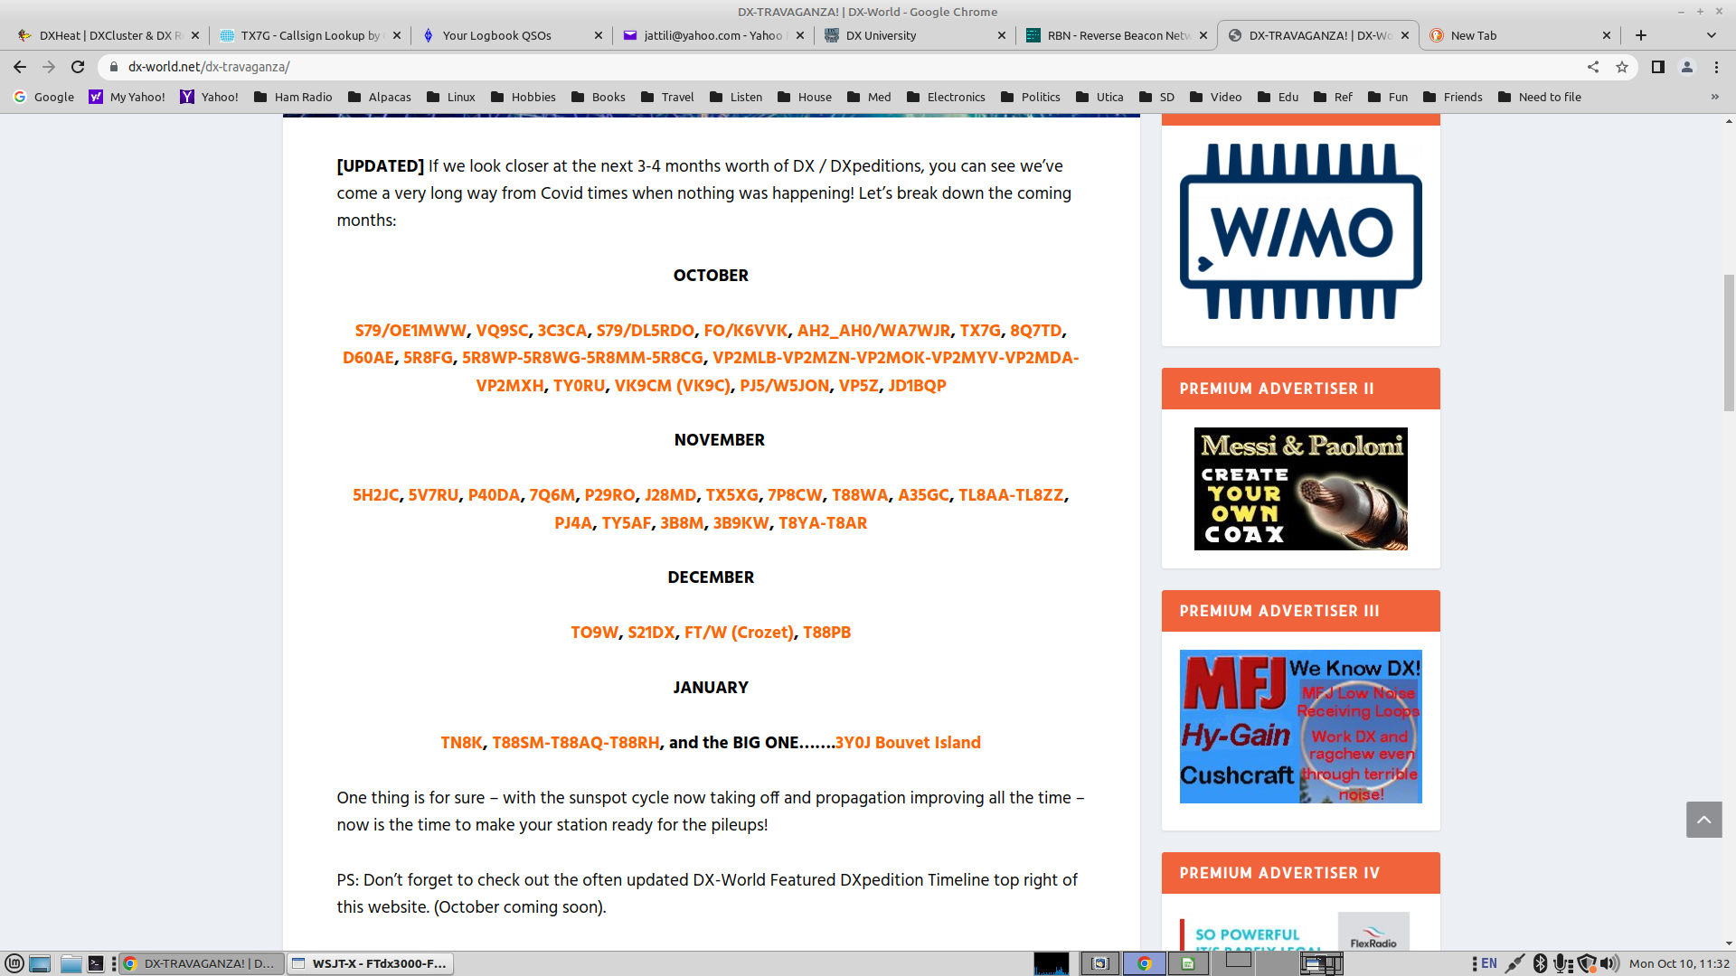
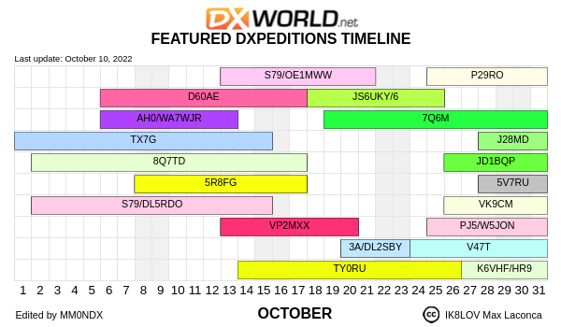
Up-coming DXpeditions

Slide 45
Chasing DX (cont.)
Do:
  Listen Listen Listen and Listen some more!
    Make sure you can hear him and verify his call!
  Figure out his timing and where he is listening and transmit accordingly
    Often UP 1-KHz or more, depending on demand
  Use full QSX (break-in) and “Split”
    Learn how to rapidly use dual VFOs and/or XIT/RIT functions on your rig
  Be courteous and concise
  Understand Propagation and Be Patient
  Take a look at QRZ.com and/or the DXpedition website for operating plans and QSL info
Don’t be the lid who:
  Tunes up and/or transmits on top of the DX!!!
  Continues to use simplex when the DX is running split (3Y0J UP)
  Continues to call when the DX is clearly calling someone else
  Thinks he’s the “DX Police”

Slide 46
My Recent Contact with D60AE (Comoros)
Turned on radio to participate in SST
Saw D60AE Spotted on 20m – clicked on it
He was ~539 and a large pile-up extending up ~10 KHz
Watched SDR waterfall to see who he was working
  About 7.5 KHz up, slowly moving down
Set my rig to “split” while listening to a few more contacts
Moved my XIT down a little more, threw out my call
  After 4 or 5 tries, he came back with WW2IL
  I sent AA2IL one more time
  Exchanged 5NNs and 73s
  Confirmed “In the Log” the next day on Clublog
Remember, I’m only running 100 W and wire antennas
  Approximately 10,500 miles distance

Slide 47
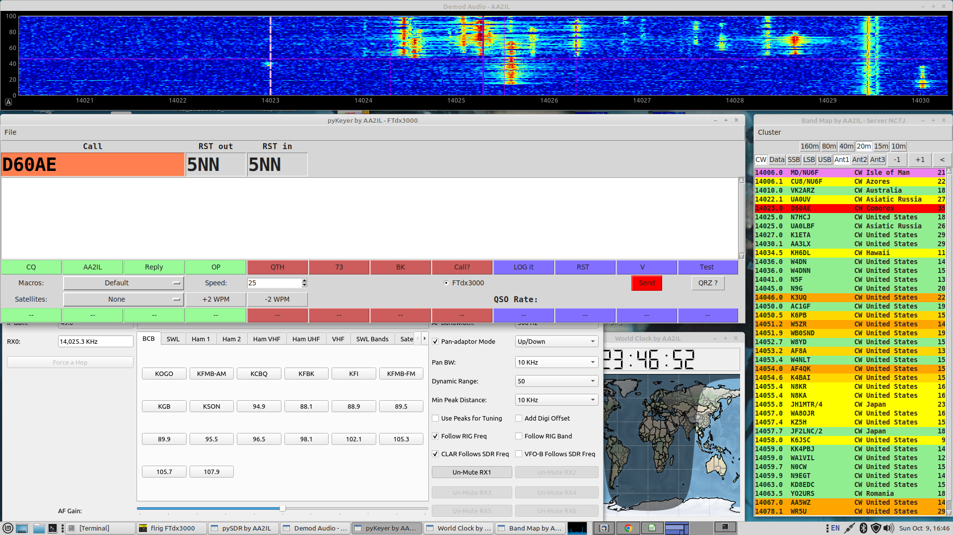
SDR Panadapter (Post-QSO)

Slide 48
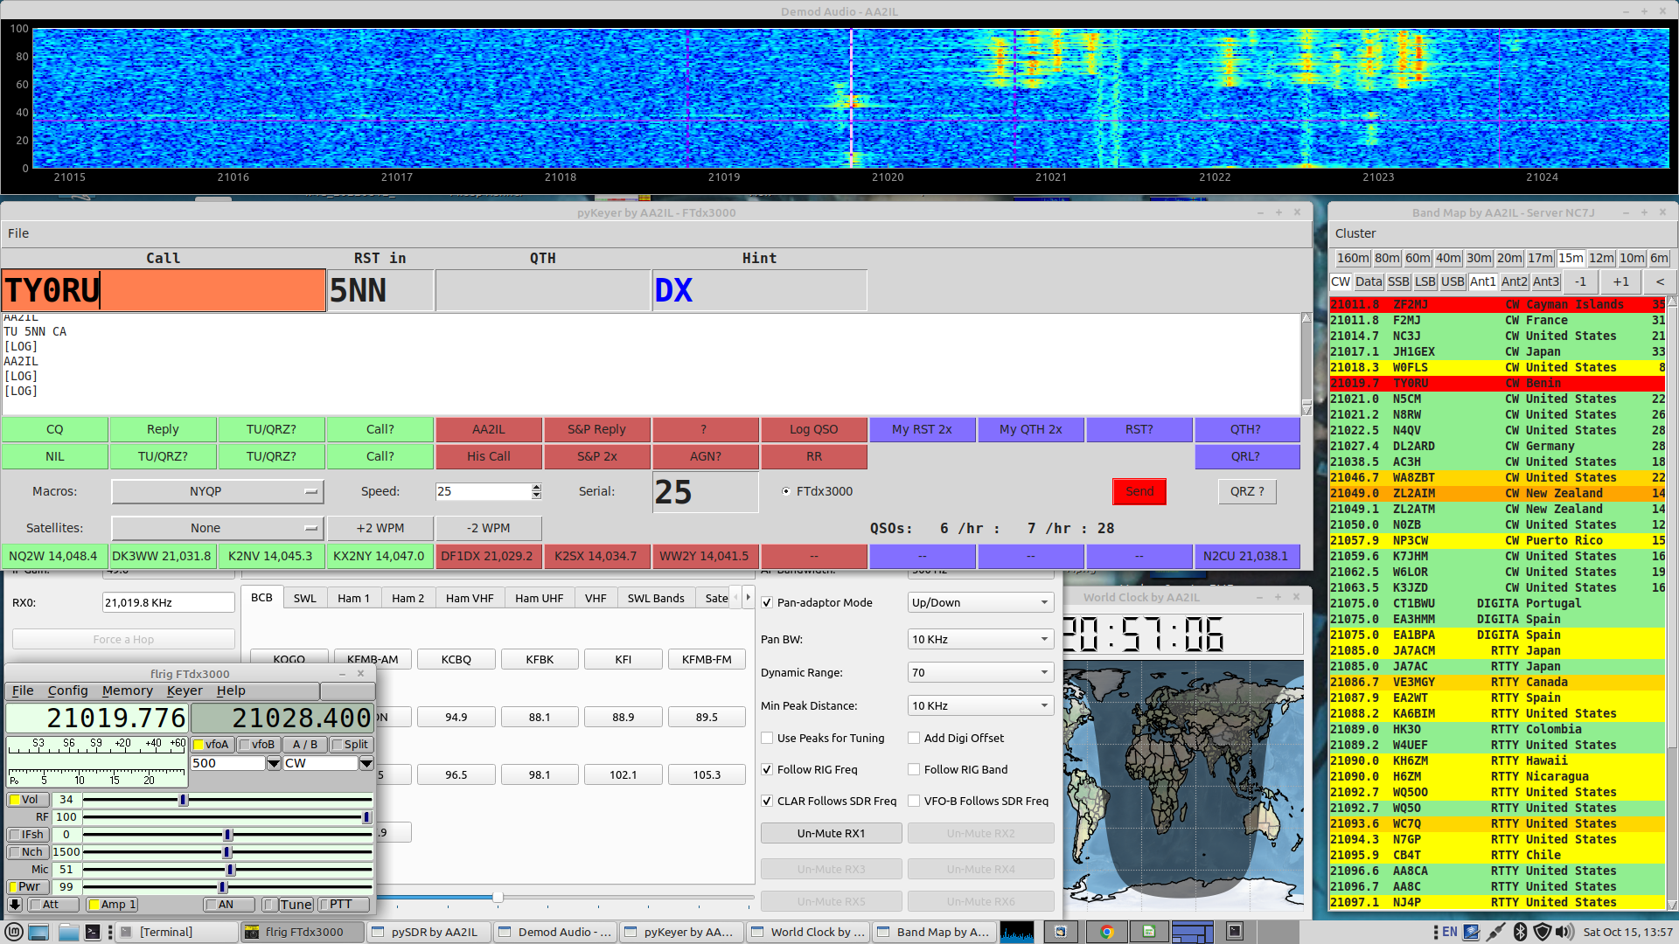
SDR Panadapter (Benin TY0RU)

Slide 49
Session 12
Go over h/w and on air activities
Upcoming contests
  CQ WW SSB
  ARRL Sweepstakes
  CQ WW CW
Loose ends:
  Jim says TS590 “Drive” output can be connected to an SDR
    Apparently intended for panadaptor or amplifier
  TS2000 doesn’t appear to have easy access to RF or IF
    Many mods showing how to tap into IF are available
  IC7610 has dual receivers and panadaptors – nice!
  Use notch filter to suppress pesky tones
Math Drill

Slide 50
CW Math Drill
1 plus 2
Is 3 R times 5
Is 15 R div 3
? 15 div 3 Is 5 R minus 1
Etc.
Use ? Or AGN? for repeats and R to confirm answer
  Try not using “voice” since you can’t on the air
No Cut Number this time -We’ll do that next time

Slide 51
Week 7 - Session 13
Go over h/w and on air activities
Upcoming contests
  CQ WW SSB (This weekend – look for CW activity DX B4 and after)
  ARRL 160m (December)
  ARRL 10m (December)
Cut Numbers
Math Drill using Cut Numbers

Slide 52
Cut Numbers
In the CWTs and many of the larger contests, you will hear ops use abbreviations for numbers in the exchange
  599 → 5NN or even ENN
  11 → AA
  100 → 1TT or ATT
  1090 → ATNT
  2198 → UAND
Other than 5NN, I don’t like this practice and advise against it
  However, others use it so you need to understand it!
Another place where a cut number can be somewhat useful is if you enter a contest late, you can send a leading “T” to alert the other station to this:
  4 → T4 or TT4
I advise against sending leading zeros for numbers above 9

Slide 53
Cut Numbers (cont.)
Acceptable:
  0 → T or the letter O
  1 → A
  9 → N
Creative (Don’t Use!):
  5 → E
  2 → U
  8 → D

Slide 54
CW Math Drill
1 plus 2
Is 3 R times 5
Is 15 R div 3
? 15 div 3 Is 5 R minus 1
Etc.
Use ? Or AGN? for repeats and R to confirm answer
  Try not using “voice” since you can’t on the air
You can use Cut Number this time – T, O, A and N

Slide 55
Session 14
Go over h/w and on air activities
Upcoming contests
  CQ WW SSB & CW – Look for DX activity B4 and after the contest
  ARRL 160m (December)
    I neglected to mention the Stew Perry 160m contest last weekend
    160m contests generally generate a lot of CW activity
  ARRL 10m (December)
QTCs
“Squeeze” Sending
A quick note about RTTY
“Grocery store” drill:
  Items you might find in a grocery store
  Build list until someone finally can remember the list
  Prior person confirms or corrects the list

Slide 56
QTCs
Some European contests include “QTCs” which add another level of difficulty to the exchange
  A QTC is the info from a previous contact you had in the contest
  True test of skill since nearly impossible to predict
Example (Time Call Number)
    CQ TEST SV2HUD
                NJ7V
    NJ7V TU 5NN 123
    TU 5NN 456
    R QTC?
                R 1608 KM6GOX 455
    R ...
YL3JD’s QTC Trainer: https://yl3jd.fizioikskile.lv/qtc/
YL3JD’s Contest Trainer: https://yl3jd.fizioikskile.lv/fsm/

Slide 57
“Squeeze” Sending
CWops encourages use of paddles and electronic keyers
  Cleaner fist at faster speeds
  Most ops “hit a wall” at 15-20 wpm using a straight key
  Eventually, you will hit a wall with a keyer also → keyboard sending
There are two types of paddles
  Single lever
  Dual lever
With a dual lever paddle, you can “squeeze” the levers together to form letters with alternating dit/dah patterns:
  Reduces number of “motions” required to form a symbol
  A, C, K, N, R, period, …
  Can even combine squeeze technique with “non-squeeze” to form most other symbols
    K, R, L, F, Q, Y, ...

Slide 58
“Squeeze” Sending (cont.)
If you don’t “squeeze,” there is no real difference between single and dual-lever paddles
There are two Iambic “squeeze” modes:
  Mode A: Sending stops after current element is sent
  Mode B: Alternate element is sent before sending stops
Excellent video demonstration by AA4OO:
  https://www.youtube.com/watch?v=6R4t3Wq1Gic

Slide 59
RTTY Contesting
Many CW contesters also enjoy RTTY contesting
  Fast paced, rates can approach those of CW
  Most modern rigs have soundcard built-in so mostly plug-and-pray
  Signaling is not as efficient as CW but higher than voice
  Ops tend to naturally spread out so its not the QRM-fest typical of FTx contests
Good place to experiment with SO2R/SO2V
  Decoding is off-loaded to your computer
Do NOT use cut numbers
  All symbols are 5-bits
  Switching between two tables with 32-symbols each
  Actually takes longer to send 5NN than 599
Send <CR> and spaces before and after your messages to help separate noise
See rttycontesting.com for more info

Slide 60
Week 8 - Session 15
Go over h/w and on air activities
Upcoming contests
  ARRL Sweepstakes – complicated exchange
  ARRL 160m (December)
  ARRL 10m (December)
Operating aids
? Drill
  Store game
  Sentances
  Ragchew QSO
  Other?

Slide 61
My Favorite Ham Websites
Contesting related:
  WA7BNM’s Contest Calendar: contestcalendar.com
  WA7BNM’s Contest Score Rumors: 3830scores.com
DX Cluster:
  DX Heat: www.dx-world.net
  DX Watch: dxwatch.com
Activity:
  Reverse Beacon Network: reversebeacon.net
  PSK Reporter: pskreporter.info
Chasing DX:
  DX World: dx-world.net
  DX News https://dxnews.com/
There are many other very good sites

Slide 62
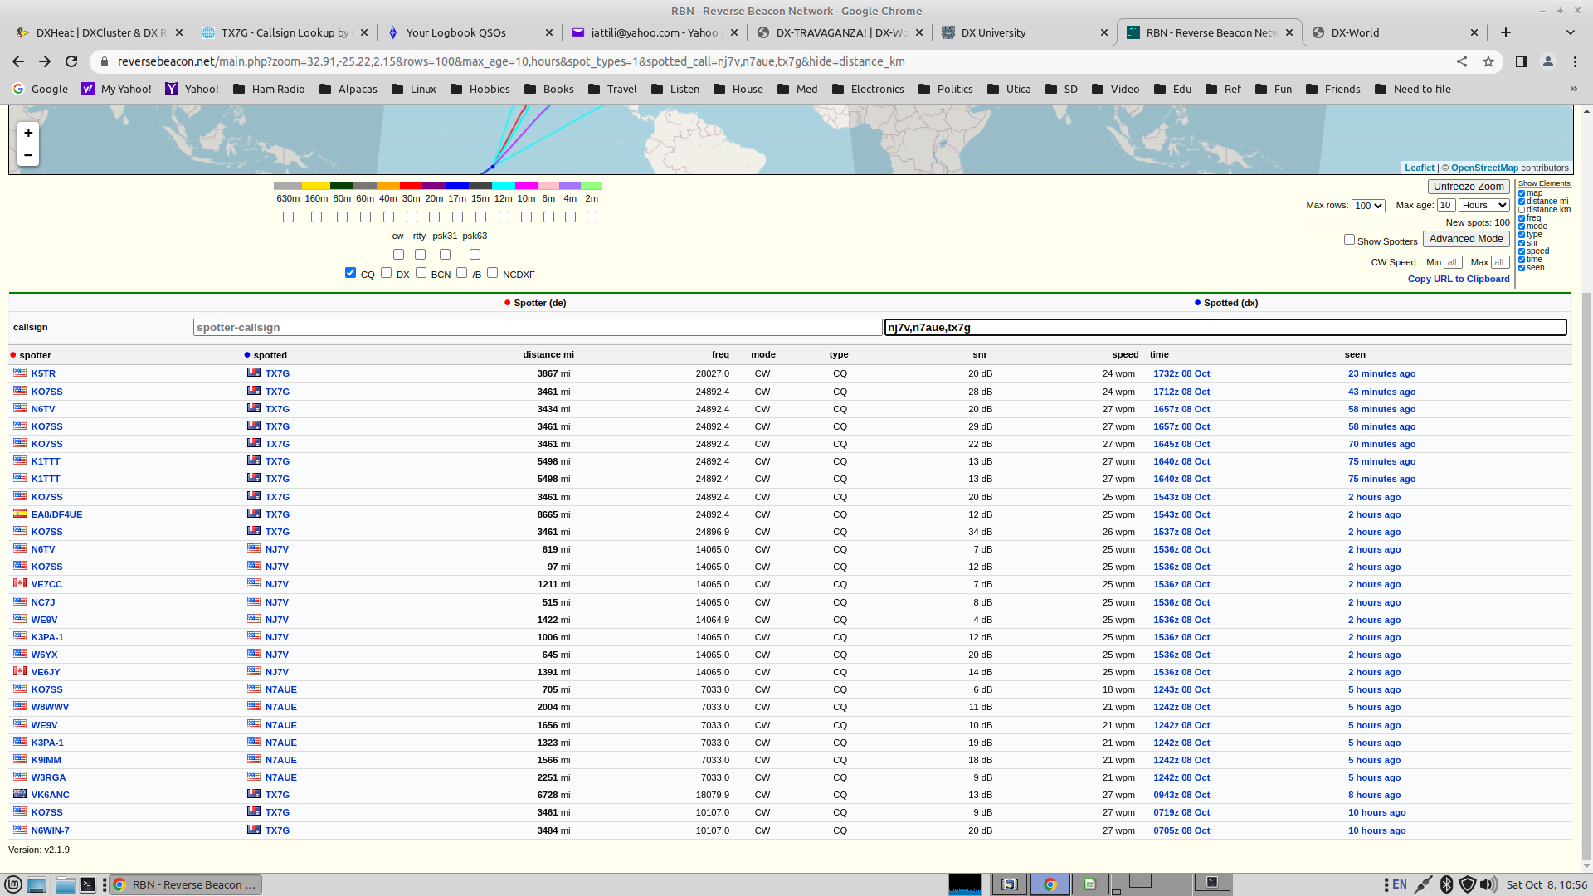
Reverse Beacon Network (RBN)

Slide 63
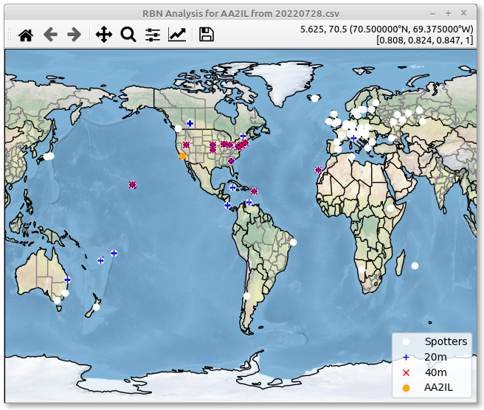
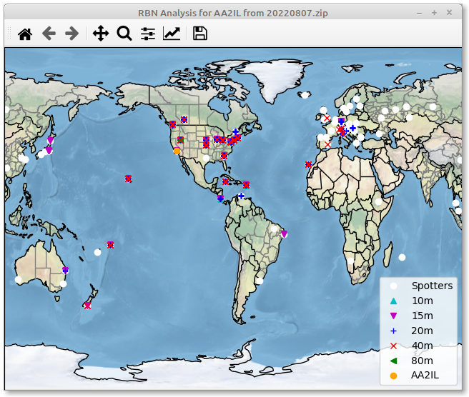
Can You Hear Me Now?
CWT 0300-0400 July 28, 2022
NAQP CW Aug 6-7, 2022

Slide 64
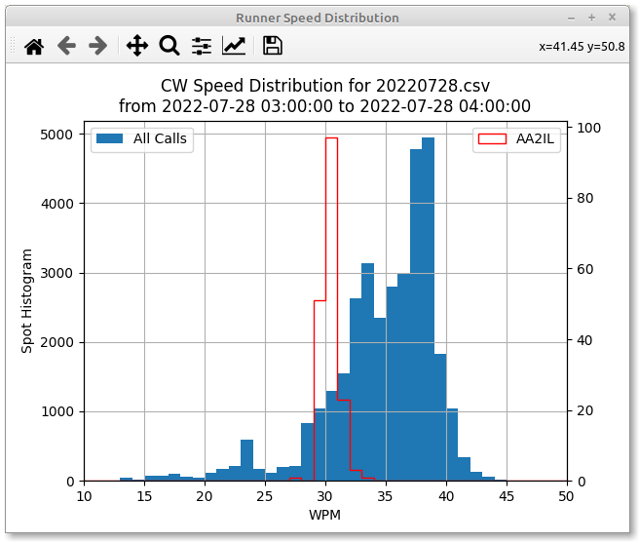
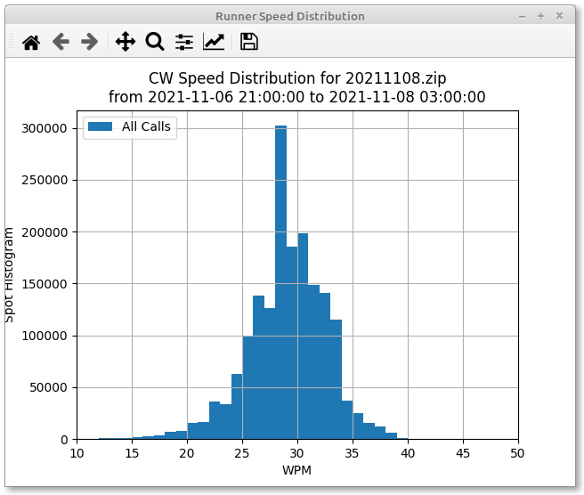
Speed Analysis
CWT 0300-0400 July 28, 2022
ARRL SS CW Nov. 2021

Slide 65
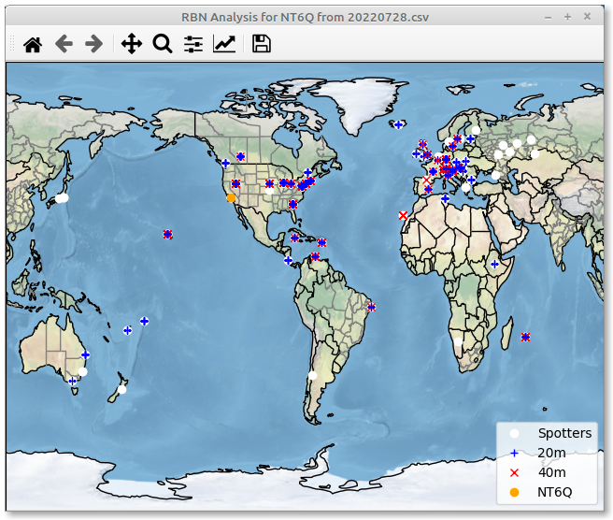
Big Gun vs Little Pistol
CWT 0300-0400 July 28, 2022
NT6Q
AA2IL

Slide 66
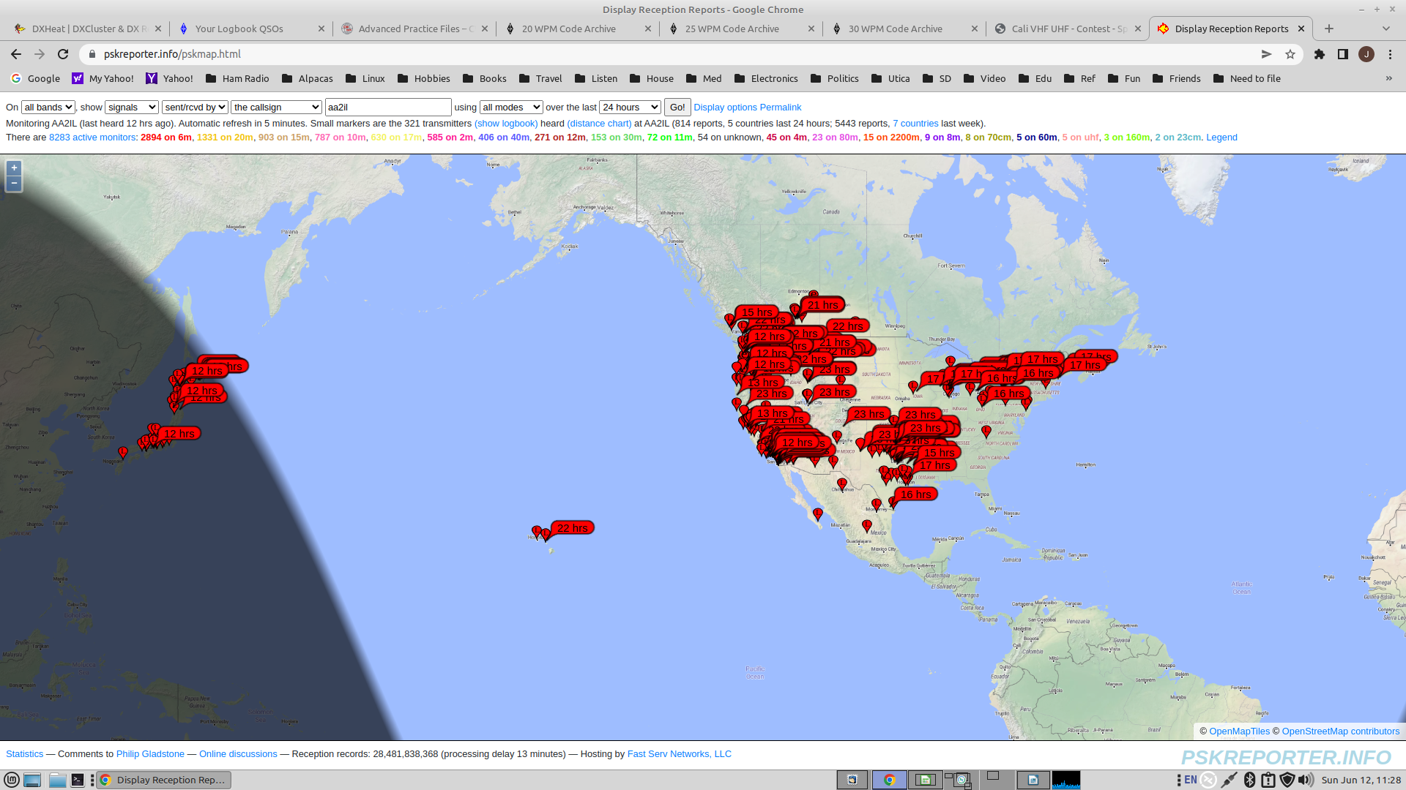
PSK Reporter – Stations Who Heard Me on 6m During the June VHF Contest

Slide 67
Session 16 – Graduation!!
Go over h/w and on air activities
Other CW contests
  NAQP – January and August
  ARRL International DX – February
  CQ WPX CW - May
  IARU HF Champs – July (WRTC)
  CWops CW Open – September
  …
CW Ops
Certificates

Slide 68
CWops Membership
Our class is unusual in that we now have 3-members
Demonstrate Proficiency at 25-WPM or higher
Nominatation + 3-sponsers
$12/yr or $100 for life
  Fee structure is changing in January so cheaper now to upgrade to life membership if you are considering this

Slide 69
CWops Activities
CWTs, CW Open, OTA Give Back, QTX
CWA - Please consider becoming a Advisor
  You can also be a co-advisor
Solid Copy - Monthly Newsletter
E-mail Reflector
Awards: CWT Participation, ACA, CMA, WAS, DXCC, WAE, WAZ ...
  Upload your logs to https://cwops.telegraphy.de/
  Post CWT summaries to https://3830scores.com/

Slide 70
Final Comments
It has been a genuine pleasure working with each of you
  You each have made significant progress
  There is an optional self-evaluation on the CWops website
Please keep in touch
Keep on practicing
Get on the air!
Please provide feedback to me on this class:
  Overall format (too much talk, not enough practice?)
  Topics you would have like to see
  Topics that we should have skipped ...
If any of you are linux hackers and are interested, I’d like some collaborators on the operating tools I showed you

Slide 71
Other Topics – Next Time?
SOTA/POTA
Sprints

